Slide 1
Artificial Intelligence: The Search Method
Introduction to Cognitive Science

Slide 2
The Cannibals and Missionaries Problem
A group of 3 cannibals and 3 missionaries is trying to cross a river, let’s say from left to right. There is a boat, but the boat holds only 2 people at a time. Also, cannibals may never outnumber the missionaries at any point in time at either side of the river, or else the cannibals will eat the missionaries. How should this group safely get across?

Slide 3
The Search Method
Search is a commonly used method in Artificial Intelligence for solving problems of this kind.
The search technique explores the possible moves that one can make in a space of ‘states’, called the search space.
Two important states are:
The start state, which embodies the ‘current state of affairs’.
The goal state, which embodies the ‘desired state of affairs’.
‘Operators’ allow one to move between states.
In search, one tries to find a path from start state to goal state.

Slide 4
Cannibals and Missionaries as a Search Problem
States can be defined as a tuple <C,M,B> where:
C is number of cannibals on the left
M is the number of missionaries on the left
B is the position of the boat (left or right)
(the number of cannibals and missionaries on the right can always be inferred from this)
Thus, the start state is: <3,3,left>
The goal state is: <0,0,right>
Examples of possible moves:
From <2,2,left> we can go to <1,1,right> (1 cannibal and 1 missionary take the boat from left to right)
From <1,3,right> we can go to <2,3,left> (1 cannibal takes the boat from right to left)

Slide 5
Part of the Search Space
X: illegal state (cannibals
outnumber missionaries on
either left or right side)
: possible move
GOAL
<1,2,right>
<2,1,right>
<0,0,right>
X
…
X
<C,M,B>
…
…
<2,2,left>
<1,1,right>
<0,2,right>
…
X
<2,0,right>
…
…
<2,1,left>
<3,0,left>
X
<3,3,left>
START
…
How to go from START to GOAL?

Slide 6
Some different Search Techniques
The previous slide illustrates that in search, we are trying to find a path from the start state to the goal state.
Some different techniques to do this:
‘Forward’ (or goal-directed) search: Start at the start state, and try and work your way to the goal state
‘Backward’ search: Start at the goal state, and find your way to the start state
‘Bidirectional’ search: Do ‘forward’ and ‘backward’ search at the same time.
‘Subgoaling’: Try and identify some intermediate states that a solution is likely to go through, and that would divide the problem into several smaller ones

Slide 7
Search Trees
Further differences in search strategies are in how paths are explored, e.g. do you just randomly try and jump from state to state, or do you try and explore the search space more systematically?
One common way to try and systematically explore the search space is through a search tree:
Start at the START state (or Goal state, or both): this is the ‘root’ of the tree, or ‘level’ 0
See which states you can reach from that state: these will be your ‘branches’ at ‘level’ 1
In general, from each state at ‘level’ n we can see what other states can be reached, which will be at ‘level’ n + 1
Note that a state at some level may reoccur at some later level. But obviously, we only need to explore each state only once, so repeats can be ignored.
Illegal states are ‘dead ends’ as well.

Slide 8
Example Search Tree
<3,3,left>
<1,3,right>
<2,3,right>
<2,2,right>
<3,2,right>
<3,1,right>
X
X
<3,3,left>
<2,3,left>
<3,3,left>
<3,2,left>
<3,3,left>
<2,3,left>
repeat
repeat
X
repeat
repeat
Etc.

Slide 9
Depth-First and Breadth-First
Search trees can be explored in different ways as well:
Depth-First search: explore one possible branch at a time, and only go back to explore an earlier state and possible new branch when you get stuck
Breadth-First search: explore all possible branches at the same time (i.e. move from level to level, finding all possible branches at each level before moving on to the next level)

Slide 10
Example Depth-First Search
<3,3,left>
1
<1,3,right>
2
3
<3,3,left>
<2,3,left>
The numbers indicate the order in
which branches/states are explored
repeat
4
5
<2,1,right>
<0,3,right>
X
6
etc

Slide 11
Example Breadth-First Search
<3,3,left>
1a
1e
1b
1c
1d
<1,3,right>
<2,3,right>
<2,2,right>
<3,2,right>
<3,1,right>
2b
2c
X
X
2a
2d
2e
2f
<3,3,left>
<2,3,left>
<3,3,left>
<3,2,left>
<3,3,left>
<2,3,left>
repeat
repeat
X
repeat
repeat
3a
Etc.

Slide 12
Some Advantages and Disadvantages of these Methods
Breadth-First Search has one obvious disadvantage in that if it takes, say, a minimum of n moves to get from the Start state to the Goal state, and if at each level, each state has an average of m ‘next’ states (this is called the ‘branching factor’ of the tree), then before a path is finally found, we have generated approximately m^{n} states. Such an exponential number can become very large very quickly, i.e. breadth-first search can take a *lot* of time.
Depth-first search does not have this problem, as it may ‘hit’ on the ‘right’ path without having to explore all the others. Then again, it is also possible that there may be a very short path from Start to Goal, but that the Depth-First method is exploring some very long paths (some infinite!) instead. So in that case, breadth-first would quickly find a solution, but depth-first might take much longer, or not find a solution at all.

Slide 13
Example: Eight Puzzle
In the 8-puzzle, numbers can be
moved left, right, up, or down
into the empty spot. The goal is
to ‘line up’ all numbers.
6
5
3
1
4
7
Start
8
2
6
5
3
6
5
3
1
4
7
1
4
8
2
8
2
7
6
5
3
6
5
3
6
5
3
6
5
6
5
3
6
5
3
1
4
7
1
7
1
4
7
1
4
3
1
4
1
4
7
8
2
8
4
2
8
2
8
2
7
8
2
7
8
2
Etc.
Note that with a branching factor of about 3, and given that in this particular set up, we know that it must take a minimum of 12 moves (since the ‘6’ must be moved at least 3 times to get into the right spot, the ‘5’ at least 1 time, etc.) to get to the goal, breadth-first search will explore something like 3¹² (appr. 1 million) states!
1
2
3
Goal:
4
5
6
7
8

Slide 14
Blind vs Informed Search
With the size of search trees (and the search space) being large for even pretty simple problems (just think of the search space for filling in Sudoku puzzles!!), search techniques need to get ‘smarter’ in handling such big search spaces.
One intuitive and useful heuristic for search is that as you are exploring different states, pick the one that gets you ‘closest’ to the goal.
Search techniques that use heuristics like this are called ‘informed’ search, whereas search techniques without any further heuristics as to guide their search are called ‘blind’ search techniques.

Slide 15
Hill-Climbing
Hill-climbing is a very straightforward way to make depth-first search a little ‘smarter’: as you reach a new branch, generate all of its ‘next’ states, and then pick from those the one that is most promising.
As usual with depth-first, go back when you get stuck.

Slide 16
Best-First Search
A slightly more involved strategy is to keep track of all states that you have generated so far, and pick from all those the ‘best’ one to explore.
Thus, you are not committed to exploring one branch, and you can jump between different branches.
This method is called ‘best-first’ search: it is sort of between depth-first and breadth-first, but with heuristics to guide its search.

Slide 17
Example: Hill-Climbing and Best-First Search
We ‘score’ every state by counting the
minimum number of moves that need to
be made in order to get to the goal
6
5
3
1
4
7
Start
8
2
12
6
5
3
6
5
3
1
4
7
1
4
8
2
13
8
2
7
11
Again, the numbers alongside
the transitions indicate the order
6
5
6
5
3
6
5
3
1
4
3
1
4
1
4
7
8
2
7
8
2
7
8
2
12
12
12
repeat
6
5
3
6
5
1
4
1
4
3
1
2
3
8
2
7
Best-First
Goal:
8
2
7
4
5
6
11
13
7
8
repeat
Hill-climbing
0

Slide 18
Search for 2-Player, turn-taking, Games
Search trees can also be used for 2-player turn-taking games such as tic-tac-toe, Connect-4, checkers, or chess:
The root of the tree (level 0) is the current board state
Assuming it is player 1’s turn, from this state we can consider all of player 1’s possible moves (level 1)
In response to each of player 1’s moves, we can consider all of player 2’s moves (level 2).
Etc.
This way, a player in a game can look any number of moves ahead, and see which moves lead to good or bad outcomes.

Slide 19
Choosing Moves
In these kinds of games, often something like the
following situation occurs:
Current state
Player 1’s turn:
A
B
Player 2’s turn:
Player 1 wins!
Player 2 wins!
Still open
Still open
In other words: Player 1 can either make a ‘risky’ move (A) or a more ‘safe’
Move (B). Player 1 may be attracted to A, because if player 2 isn’t careful,
player 1 wins. However, if player 2 is careful, player 1 will actually lose. So,
what to do? Take the risk and hope that your opponent does something ‘stupid’,
or play it safe?

Slide 20
The Max-Min Strategy
One possible strategy in choosing moves is to assume that the opponent never does something stupid, and in fact always makes the move that is best for him/her/it.
The Max-Min strategy is based on this assumption:
Generate the search tree as far as you can
Now use some kind of scoring rubric to assign a score to the very last states: the better it is for player 1, the higher the score
Now work your way back up the tree, and score each of the earlier states as follows:
If it is player 1’s turn, then the score is the maximum of the scores of the states immediately below it (i.e. pick the best move for player 1)
If it is player 2’s turn, then the score is the minimum of the scores of the states immediately below it (i.e. pick the best move for player 2)

Slide 21
Example Max-Min Strategy
x
Only some of the
Branches are shown!
Tic-Tac-Toe: o to play
o
x
Pick max
x
x
o
o
x
o
min = 0
x
o
So pick this one!
Pick min
i.e. will lead to loss
x
x
x
o
max = 0
x
o
x
o
x
o
max = 1
Pick max
x
x
x
x
o
x
o
o
o
x
o
x
o
o
min = 0
x
o
min = 0
x
o
Score = 1
Pick min
x
x
x
x
x
x
o
o
o
x
o
o
Score = 0
x
o
Score = 0

Slide 22
Chess, Combinatorial Explosion, and Computers
It is estimated that the average number of moves that one can make during a chess game is about 30. Also, typical games of chess take about 80 moves. So, the search tree for chess would have about 30⁸⁰ states which is about 10¹²⁰ board states!!
Deep Blue, the chess computer that beat Kasparov, was able to look about 8 moves ahead, which means that it would consider about 30⁸, which is about 10¹² (1 trillion), possible board positions. Deep Blue was able to do this because of its enormous speed.

Slide 23
Search and Human Problem Solving
It is unlikely that Kasparov contemplates 1 trillion board positions during every of his turns, and yet Kasparov can still play almost as good as Deep Blue. So, either Kasparov uses some very powerful heuristics that drastically prune the search-tree, or Kasparov doesn’t use any search at all.
Many cognitive scientists believe that we heavily rely on certain ‘patterns’ that tell us that ‘if you are in a situation that looks like this-or-that, then make such-and-so a move’. For example, just a few of such ‘rules’ allow one to play perfect tic-tac-toe without doing any search at all.
Some cognitive scientists estimate that someone like Kasparov has thousands of such abstract patterns stored in his brain.

Slide 24
The Monk and the Mountain Problem
One day, a monk walks to the top of a mountain, starting at noon in the valley, walking at various speeds, and taking various stops at various times. The next day, the monk walks back to the valley, again starting at noon, and using the same path, but again using various speeds and stops.
Question: is there a point in time during the second day at which the monk is at an exact point on the mountain where the monk was exactly 24 hours earlier as well?
Answer: Yes, there has to be such a point. Imagine the two walks not happening 24 hours apart, but happening at the same time. Then at some point the monk walking up must meet his imaginary counterpart walking down. That very point on the mountain path must therefore be the point we were looking for!

Slide 25
‘Insight’ Problems
The Monk-and-the-Mountain problem is what is called an ‘insight’ problem: solving it requires some kind of ‘insight’.
Indeed, it is hard to see how one could try and solve this problem using a search strategy: what would the search space even look like?!
At this point, AI (and cognitive science) is really at a loss explaining how ‘insight’ works and how it can be formalized.
Indeed, some people believe that AI will never be able to capture this (much like the Lady Lovelace argument).

Slide 26
The Monkey and the Banana
In one study on monkey’s problem-solving powers, experimenters hung a banana from the ceiling in a room, where there was also a box and a stick.
The banana was placed at such a height, that the monkey could only reach the banana by placing the box right under the banana, standing on the box, and swinging the stick at the banana.
Some monkeys solved this problem, but not all.
How would an AI do?
Well, suppose we were to provide the AI with the following operators: ‘move-box-under-banana’, ‘grab-stick’, ‘climb-on-box’, and ‘swing-stick-at-banana’. Would an AI search algorithm find the solution?

Slide 27
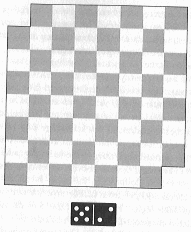
The Mutilated Chess-Board Problem
Can you place dominoes onto this
‘mutilated’ chessboard such that all
squares are covered?
(the dominoes cover exactly two adjacent
squares, and you are not allowed to place
dominoes on top of each other)

Slide 28
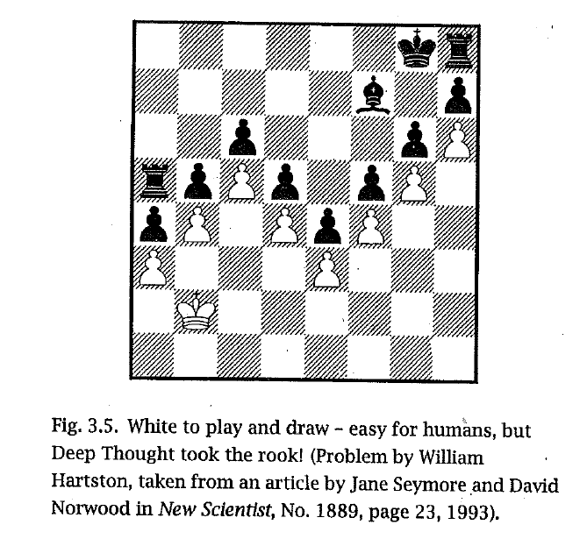
Another Chess Problem

Slide 29
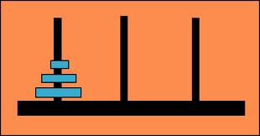
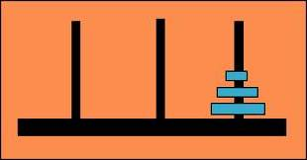
HW 2: The Towers of Hanoi
?
START
GOAL
A move consists of taking a disc from the top of a pile of discs on
any peg and move it on top of a pile of discs on any other peg.
You can never have a disc on top of a larger disc.
Let <123,_,_> represent the START condition:
All 3 discs are on the left peg, with the largest (1) at the
bottom and the smallest (3) on top. The GOAL is <_,_,123>.
1→2 represents a move that takes a disc from peg 1 to peg 2

Slide 30
HW 2: The Towers of Hanoi
Breadth-First
1→3
1→2
1→3
1→2
3→2
3→1
1→3
1→2
2→3
2→1
X
repeat
repeat
X
repeat
repeat
…
…
?
?

Slide 31
HW 2: The Towers of Hanoi
Depth-First
Use this order:
1→3
1→2
2→3
2→1
3→2
3→1
1→3
1→3
1→2
X
1→3
1→2
2→3
?
X
X
X

