Slide 1
More Perception
Introduction to Cognitive Science

Slide 2
Motion Perception

Slide 3
The problem of motion perception
How are properties of the 3D world (structure and motion of objects) specified in the changing 2D image (as further complicated by eye, head, and body movement)?

Slide 4
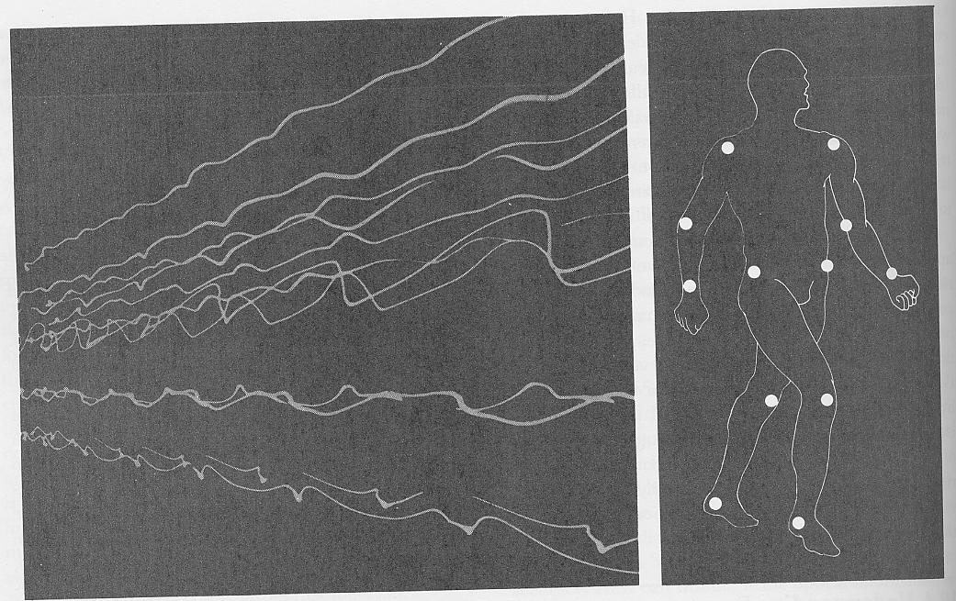
Biological motion
Czechslovakia (1960s): Black Light Theatre
Gunnar Johansson (1970s): Point light walkers

Slide 5
Biological motion: Main results
Static image perceived as meaningless configuration of dots
like a constellation of stars
Dynamic image perceived as person in motion
in as little as 200 ms
Subjects could accurately discriminate:
different activities (walking, dancing, limping, doing pushups)
different genders
different individuals (self vs. roommate)
weight of a lifted box
Significance:
it doesn’t take a lot of input to recognize something
just need strategic input (lights on shoulder, elbow, etc)
and motion helps! (not hurts!)

Slide 6
The Barber Pole Illusion

Slide 7
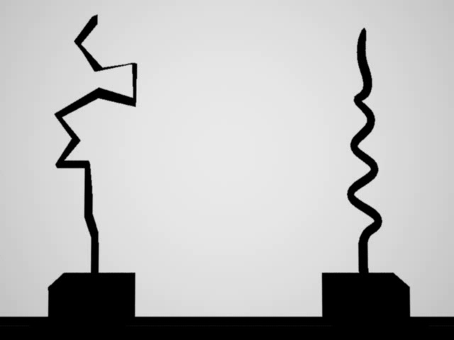
Rotating Poles

Slide 8
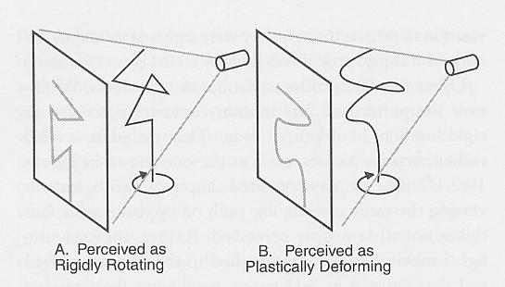
The Correspondence Problem
The correspondence problem is to figure out which ‘pixel’ from an earlier ‘snapshot’ corresponds with which ‘pixel’ from a later ‘snapshot’
This is (much) easier to do in A as the end points of the straight ends can be put into such a correspondence. For B, we don’t know which point in the later snapshot corresponds to which point in the earlier snapshot. Hence, our brain gets confused.

Slide 9
Correspondence Problem for Barber Pole
Easily
‘identified’
point
This is the original
point, but there is
no easy way to
identify (or track)
it as such
Spin to right
Re-
‘identified’
point (whoops!)
Or: do we correspond the whole red patch with the whole other red patch?

Slide 10
The Problem of Integration
We perceive the world as ‘one whole’. But we get bombarded with separate pieces of sensory information all the time. How do we ‘put it all together’?
The correspondence problem is just one example of this problem of integration.
But we can also integrate over the different spatial cues we just saw.
And then we need to integrate spatial perception with object perception.
And we integrate over different senses.
And we integration over time!
Some examples of ‘integration’ follow

Slide 11
The Correspondence Problem for Stereopsis
In order to figure out any binocular disparity, we’ll have to figure out which parts of the left eye image corresponds to which parts of the right eye image.

Slide 12
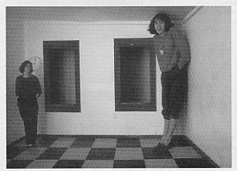
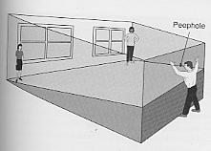
The Ames Room

Slide 13
Cue Conflict
The Ames Room shows that cues can be in conflict, and this may well happen in natural conditions as well, where one cue says one thing, yet another cue says something different.
How does the visual system deal with this?
Possible ways of dealing with this:
Dominance: assign some kind of priority to certain cues over other cues
Compromise: Take some kind of ‘average’

Slide 14
The Binding Problem
Neuroscientists have found some very specific (and separate) parts of the visual cortex performing some very specific tasks:
Discriminating shapes
Discriminating colors
Discriminating textures
Etc.
But how does all this information get together again? How, for example, is it that we perceive a ‘red pen’ next to a ‘blue notebook’? How did the ‘red’ go with the ‘pen’, and the ‘blue’ with the ‘notebook’? Why not the other way around? Why not 4 different objects?

Slide 15
Living in the Past …
http://www.youtube.com/watch?v=BTOODPf-iuc&list=UU6nSFpj9HTCZ5t-N3Rm3-HA&index=9&feature=plcp
Stopped Clock Illusion

