Slide 1
Embedded Cognition
Minds and Machines

Slide 2
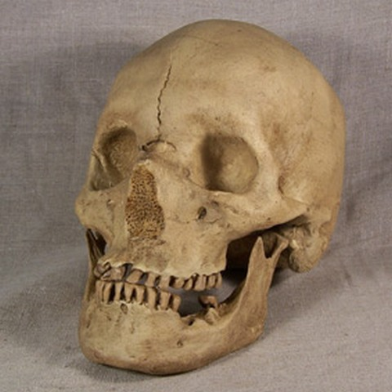
Wallace’s Paradox

Slide 3
Neil DeGrass Tyson on Human Intelligence

Slide 4
The Astonishing Hypothesis
“You, your joys and your sorrows, your memories and your ambitions, your sense of personal identity and free will, are in fact no more than the behavior of a vast assembly of nerve cells and their associated molecules.”
- Francis Crick, “The Astonishing Hypothesis”

Slide 5
Brain Gives Rise to Mind Hypothesis
Intelligence, cognition, mind, etc. are all a function of the brain
Cognition = f(Brain)

Slide 6
‘Sense, Plan, Act’
Sense
Cognition
Act
Agent
(Brain)
Environment

Slide 7
LEGO Robot Solves Sudoku!

Slide 8
Embedded Cognition
Sense
Processing
Act
Agent
(Brain)
Environment

Slide 9
Catching a Fly Ball

Slide 10
The World as External Memory
Embedded Cognition proponents say that the brain often uses the environment as a kind of ‘external memory’.
Examples:
Notes, planners, calendars, even laptops

Slide 11
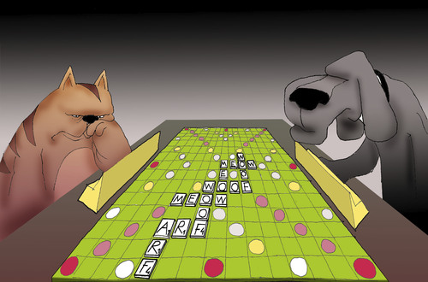
No Opposable Thumbs …

Slide 12
The World As its own Best Model
Situated cognition proponents like to point out that we don’t always form some kind of internal representation of the outside world

Slide 13
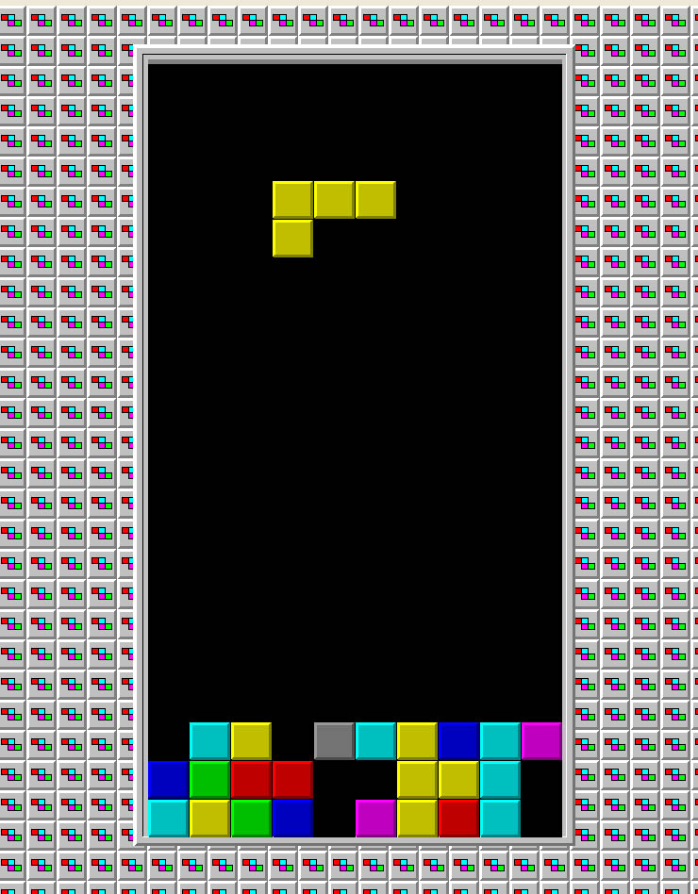
‘Epistemic moves’:
Moves that are not
part of a solution,
but help find one
Rotating
Slamming

Slide 14
Blind-Cane-Man
Bob is blind, and uses a cane to feel around.
Is the cane part of Bob?
It isn’t part of Bob as a biological being.
But is it part of Bob as a cognitive being?
There is a cognitive agent here, perceiving the world, thinking about the world, etc.
Is the cane part of the cognitive agent, or part of the world?
Is Bob a cyborg?

Slide 15
Does Tool Use create a new Cognitive System?
World
World
Tool
Cognitive
System A
Cognitive
System A
Cognitive System B

Slide 16
Projection: Imagined Abaci

Slide 17
Language: Our Best Tool?
Language seems to be an especially powerful tool that we use to enhance our cognitive abilities:
Expressions of language can be used to represent information and thus serve as external memory (see examples before)
Expressions of language can be manipulated and thus reasoning and decision-making can take place (logic, mathematics, science)

Slide 18
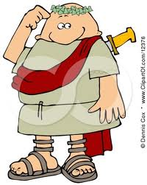
Some Representations Are Better Tools Than Others …
VI / XLIV \ ??

Slide 19
Objection: Higher-Order Cognition without Interactions
OK, but then what about someone who is just sitting in a chair, contemplating something or other?

Slide 20
World
World
Representation
of World
Cognitive
Agent A
Cognitive
Agent A
Cognitive System B

Slide 21
Culture

Slide 22
Wallace’s Paradox

Slide 23
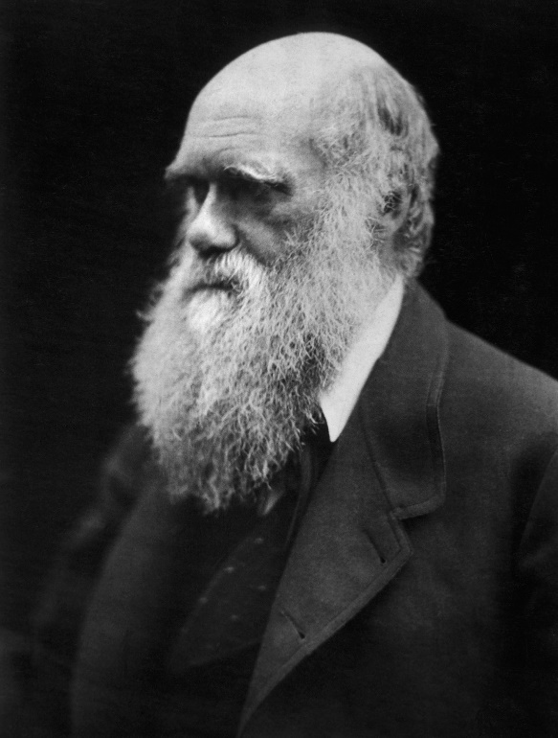
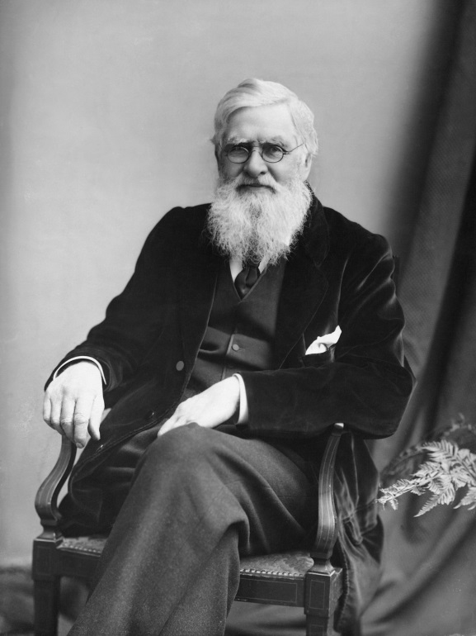
Darwin
Wallace

Slide 24
Culture
Culture is the whole of:
Ideas and Concepts
Knowledge and Beliefs
Behaviors and Habits
Practices and Methods
Tools and Skills
…
These aspects of culture exist in ‘social space’ … not in your head.
But they clearly enhance your cognitive abilities.

Slide 25
Language and Cultural Transmission
Again, language plays a key role in cultural transmission, since we can use language to describe:
Thoughts, Concepts, Ideas, Beliefs, Tools, Skills, Behaviors, Habits, Procedures, Routines, …
And these descriptions are more easily transmitted, and they last: they can be passed over great distances in both space and time.

Slide 26
Cultural Evolution of Cognition
Once culture is in place, cultural evolution can work on components of cognition.
For example, such cognitive ‘building blocks’ as concepts or ideas, but also fashions and values can be passed from organism to organism, where they ‘compete’ for existence (certain ideas strike us as better ones than others’, and can get mutated or combined with others: all the ingredients that an evolutionary process requires.
Richard Dawkins coined the term ‘memes’ for these kinds of entities that are subject to cultural evolution.

Slide 27
Cultural Evolution Exhibit A: Theory of Evolution
Darwin
Wallace

Slide 28
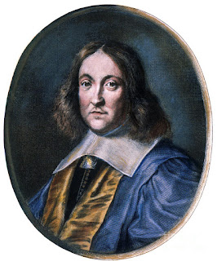
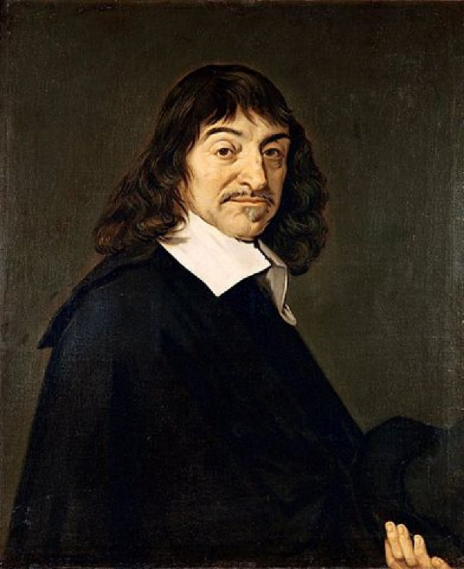
Analytic Geometry
Fermat
Descartes
(building on the work by Apollonius, Viete, and others …)

Slide 29
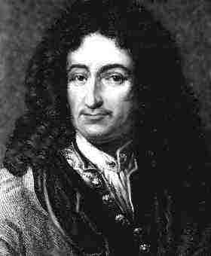
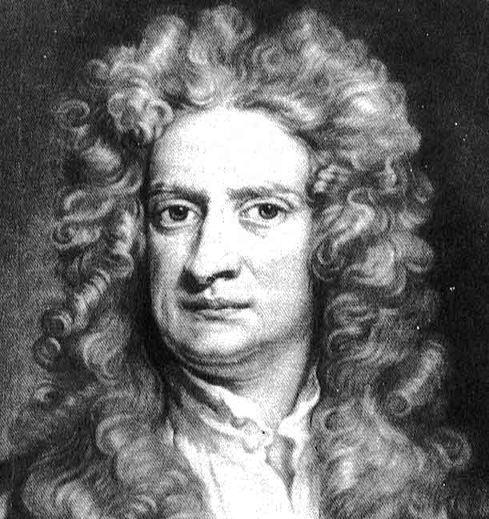
Calculus
Leibniz
Newton
(building on the work by Archimedes, Kepler, Roberval, Cavalieri,
Lagrange, Huygens, Barrow, and many others … including Descartes
and Fermat’s work on analytic geometry!)
Newton: “If I have seen further it is by standing on the shoulders of giants.”

Slide 30
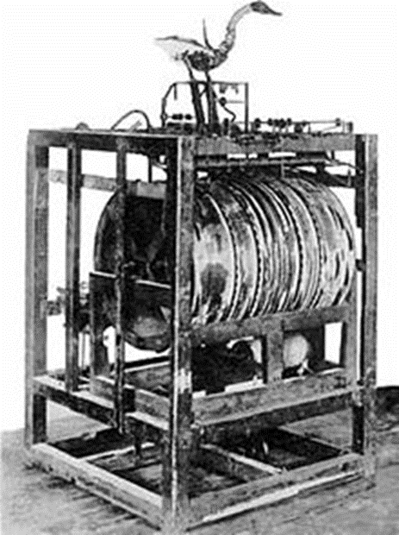
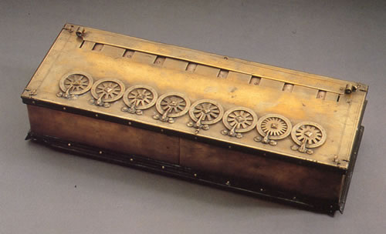
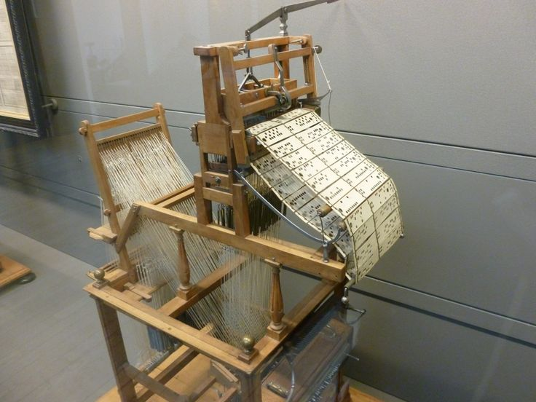
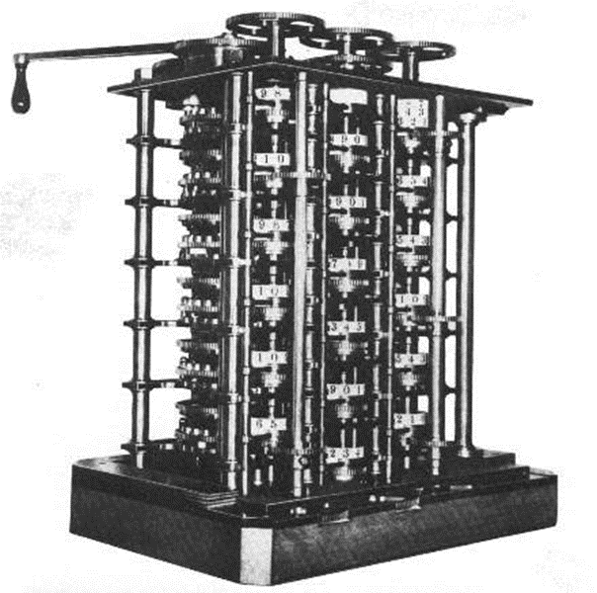
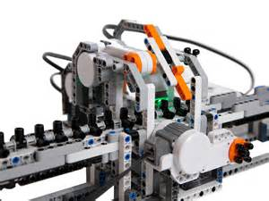
Who Invented the Computer?
Symbol
manipulation
Instructions
Machines
Computations
‘Digesting’ Duck
Mechanization of Computations
Programmable Machines
Pascal’s Calculator
Programmable Computers
Jacquard Loom
Babbage Difference Engine
Universal Programmable Computers
Turing Machine

Slide 31
How our Brain Integrates Technology: Perception

Slide 32
How our Brain Integrates Technology: Action

Slide 33
Hammer-Man!
Hammers
don’t hit Nails,
People Do!
“If all you have is a hammer,
everything becomes a nail”
- Bernard Baruch

Slide 34
Wallace’s paradox is that our human ancestors from tens of thousands of years ago had pretty much the same brain capacity as we have now. Hence, they should have been able to do advanced mathematics, science, etc. But they didn’t. So it seems like a lot of their brain power wasn’t used. But that goes against the basic tenets of evolution, since evolution wouldn’t favor organisms that waste energy on things that aren’t being used. What is probably the best resolution to this paradox?
A. The human mind is not physical, so evolution has nothing to do with it. Ha!
B. Evolution *does* waste. We all know we only use 10% of our brain! Booyah!!
C. One’s mental capacities are a function not just of the brain alone, but of brain, body, and environment. And while our brains and bodies are essentially the same as our ancestors, we have sophisticated languages and other symbol systems in our environment to do math and science, which our ancestors did not.

Slide 35
True or False? Leibniz and Newton coming up with calculus at the same time but without any contact is an amazing coincidence!
A. True
B. False

Slide 36
Symbolic AI
Symbolic
Language
Tools (Natural
Language, Math,
Science, Culture)
Rest of World
Sub-Symbolic AI
‘Simple’
Cognitive
System A
(brain)
‘Advanced’
Cognitive
System B
Body of
Cognitive
Agent

