Slide 1
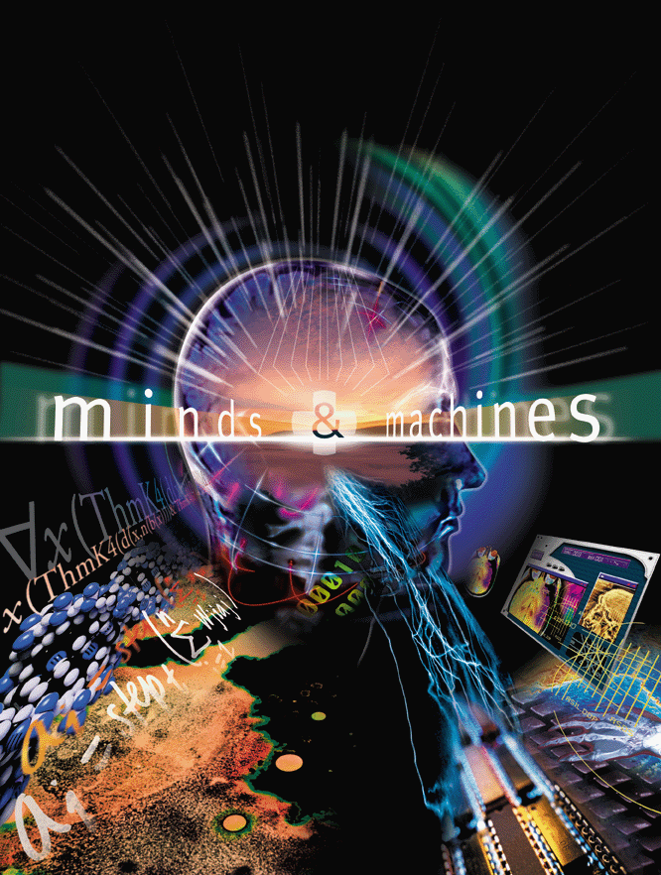

Slide 2
Attendance
A. I am here
B. I am not here

Slide 3
Brains, Minds, Knowledge, and Reality
Minds and Machines

Slide 4
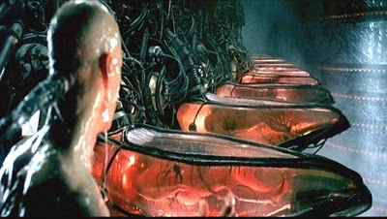
(1999) The Matrix

Slide 5
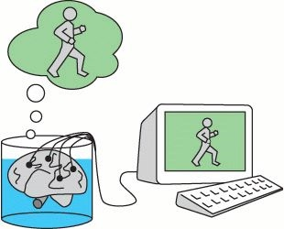
(Putnam, 1981) Brains in a Vat

Slide 7
Attendance Revisited
A. I am here
B. I am not here
C. I don’t know where I am
D. Frankly, I don’t know if I even exist!

Slide 8
(Descartes, 1641) Evil Genius
Can I be certain that what I perceive is really there?
Maybe I’m dealing with a perceptual illusion
Maybe I’m hallucinating
Maybe I’m dreaming
Maybe some supernatural being (the Evil Genius) is generating my perceptions
Is there anything whose existence I can be certain of?
Well: I think. Therefore, I am!

Slide 9
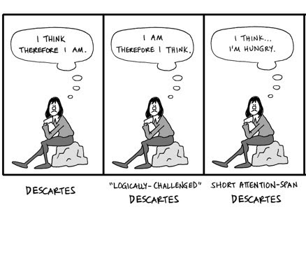

Slide 10
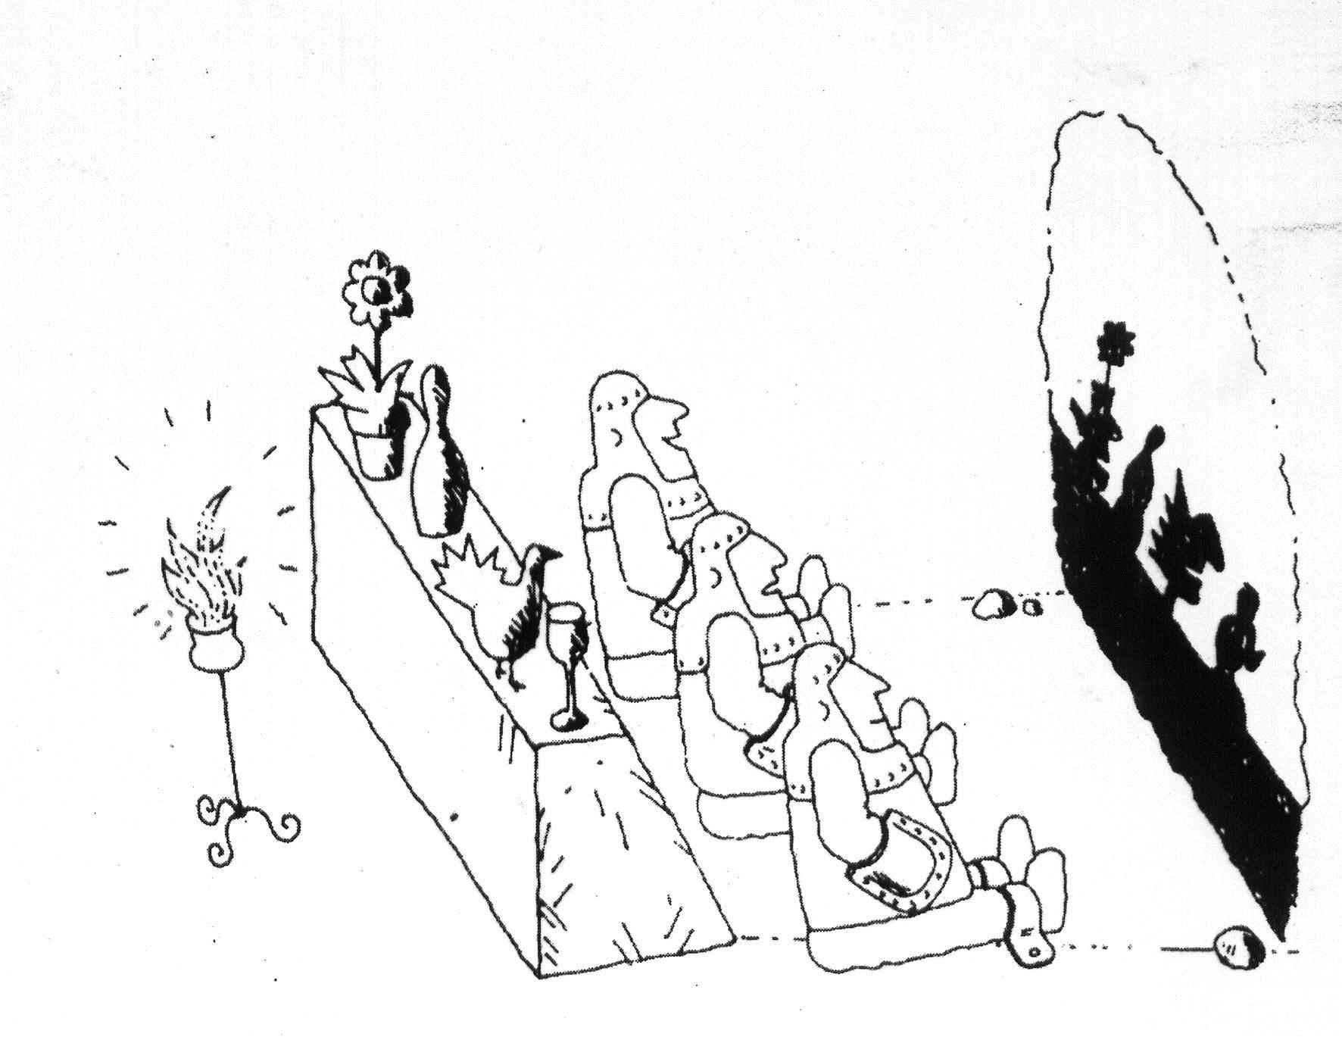
(Plato, ~380 B.C.) Allegory of the Cave

Slide 11
Is a perfect illusion really an illusion?
If this right now were really just a computer simulation inside a larger world, would it matter?
Would it be less real?
Would our passions/relationships/hopes be any less valuable?
Would the choices we make be any less free?
Does it make sense to worry about the outside world?

Slide 12
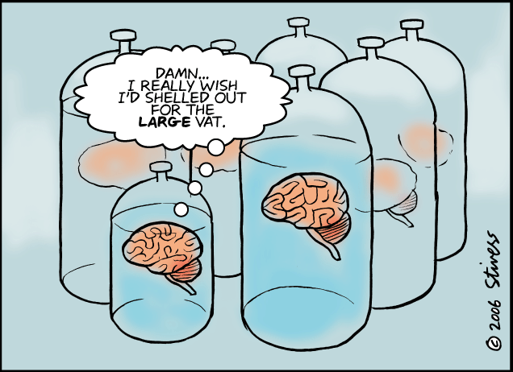

Slide 13
Another Question
Is a “brain in a skull” any less puzzling or disturbing than a “brain in a vat”?
brain still generates experience from input.
still big possible mismatch between experience and reality.
it’s all a construction, either way.

Slide 14
Quiz Question 1
On Descartes’ view, can we be certain that we have a brain given that we have thoughts, i.e. “I think, therefore I have a brain?”
A. Yes
B. No

Slide 15
Quiz Question 2
Will Descartes try to avoid a rock that he sees coming straight at him?
A. No, the rock does not exist.
B. No, any pain he will feel is not real.
C. Yes. While he is not certain the rock exists, it probably does exist and probably will hit him and probably be very painful
D. No, he has just as much reason to believe that the rock will get to where he is standing now as that it gets to the place he will move to. So he might get hit either way … or not … it’s all a crapshoot really. So why bother? Save some energy. Dude!

Slide 16
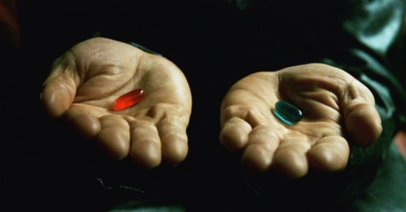
Movie Time!

