Slide 1
Perception, the Brain, and Consciousness
Minds and Machines

Slide 2
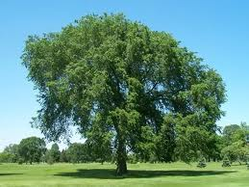
Our Eyes as a Window to the World

Slide 3
The Myth of ‘Perfect’ Perception
The myth of perception is that as long as:
Our eyes are functioning properly
We’re not wearing rose-colored glasses
We’re not drugged
We’re not subjected to some visual illusion
We’re not in the Matrix
… (other exceptional/rare situations)
… we perceive the world exactly as it is.
Wrong!

Slide 4
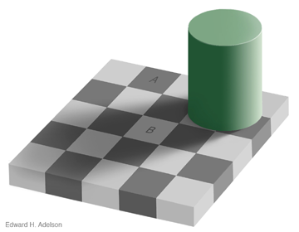
The Checker Board Shadow Illusion
A
B

Slide 5
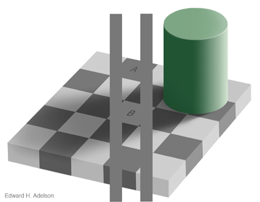
The Checker Board Shadow Illusion
A
B

Slide 6
Perception is Constructive!
At all times, how we perceive things is a construction of our mind (brain).
Perception = f(raw sensory input, attention, beliefs, expectations, …)
A very complex function!
It is estimated that about a third of our brain is dedicated to visual processing alone!

Slide 7
Why Perception Doesn’t Feel Constructive
Two big reasons:
We are, under normal circumstances, getting a lot ‘right’
I rarely get contradicted in my constructions of reality and how I subsequently act on that
We consistently perceive the world in the same way (i.e. we’re stuck in Plato’s cave)

Slide 8
Further Philosophical Questions
What are things in the world really like?
How is knowledge and science possible?
How do I know what it is that you perceive?
Do you have any conscious perceptions?
Do animals and machines have any conscious perceptions?
What is consciousness, where is it, and why is it even there?

Slide 9
What is Really out there?
I see a tree
?

Slide 10
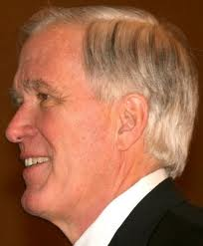
The Problem of Other Minds: What do You See?
I see a tree
?

Slide 11
Invertoids
I see a tree
?

Slide 12
Weirdoids
I see a tree

Slide 13
Who’s the Invertoid?
I see a tree
?

Slide 14
‘Publicly Observable’
1 tree
E = mc²
!

Slide 15
The Puzzle of Consciousness
Some brain activity ‘leads to’ conscious experiences, but other activity does not. Why?
Indeed, if we can process so much visual information unconsciously, why do we have any conscious visual experiences at all??

Slide 16
Zombies
I see a tree!

Slide 17
Zombie Argument for Dualism (well, against Materialism)
Premise 1: I can imagine a philosophical zombie counterpart of myself: a being whose brain goes through the exact same processes that my brain goes through (and thus who acts and behaves just like I do), but that has no conscious experiences
Intermediate result 1: Therefore, it is possible to have all the physical processes going on in my brain without having any experiences
Premise 2: If materialism is true, then my conscious experiences are the logical result of the physical processes going on in my brain
Intermediate result 2: Therefore, if materialism is true, then it is impossible to have all the physical processes going on in my brain without having any experiences
Conclusion: Consciousness is not physical. Materialism is false.

Slide 18
Blindsight
I don’t have any conscious experience,
but I think there is a tree

Slide 19
Blindsight and Animal Consciousness
Blindsight is often explained by pointing to the fact that there are two neural pathways from our eyes to our visual processing centers in (the back of!) our brain: one evolutionary old pathway (through the brain stem), and one new (through the thalamus)
But why does one pathway lead to conscious experiences and the other not?

Slide 20
Materialist Theories of Consciousness
Consciousness is:
quantum collapses in microtubules internal to neurons (Penrose, Hameroff)
thalamically modulated patterns of cortical activation (Llinas)
left hemisphere based interpretative processes (Gazzaniga)
emotive somatosensory hemostatic processes based in the frontal-limbic nexus (Damasio)
synchronous neural oscillations at 40-70Hz in the claustrum (Crick, Koch)
spatiotemporal patterns in electro-magnetic field produced by brain (McFadden, Pockett)
global workspace of cognitive activity (Baars)
integrated information (Tononi)

Slide 21
Quiz 1
“As long as I am not drugged or wear rose-colored glasses, or am subjected to a carefully constructed visual illusion, I see the world as it is.
True or False?
A. True
B. False

Slide 22
Quiz 2
The Zombie Argument is:
A. According to Materialism, consciousness has a purely physical basis. This means that it is impossible to have that physical basis without being conscious. However, we can conceive of zombies, which are beings that are physically identical to us, but that aren’t conscious. Therefore, Materialism must be false.
B. The Problem of Other Minds states that you don’t know if someone other than yourself is conscious. However, if we wouldn’t be conscious, then we would be like zombies. Since we can see that no one behaves like a zombie, we know that other people in fact are conscious. So there is no Problem of Other Minds.

Slide 23
Video: Secrets of the Mind
This Nova episode follows neuroscientist V.S. Ramachandran as he tries to relate unusual mental behaviors or disorders to brain damage, thus also suggesting how ‘normal’ brains give rise to mental phenomena.

