Slide 1
The Turing Test
Minds & Machines

Slide 2
Can Machines be Persons?
In legal contexts, a person is something with certain rights … often linked to their interests:
To have a right about X, one needs to have an interest in X
But to have an interest in X, one needs to be mentally aware of X (rocks have no mind, so no interests, so no rights)
So, to have a self-interest (e.g. right to one’s own life), one needs to be self-aware?

Slide 3
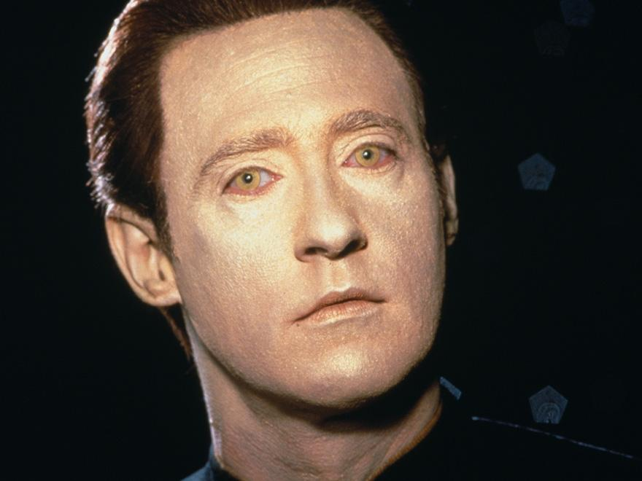
Commander Data
Star Trek TNG:
The Measure of a Man
(aka ‘Data on Trial’)
Is Commander Data a person?
Does Commander Data have rights?
Is Commander Data sentient?
Is Data intelligent? Self-aware? Conscious?

Slide 4
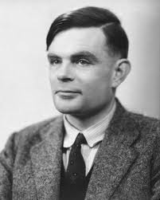
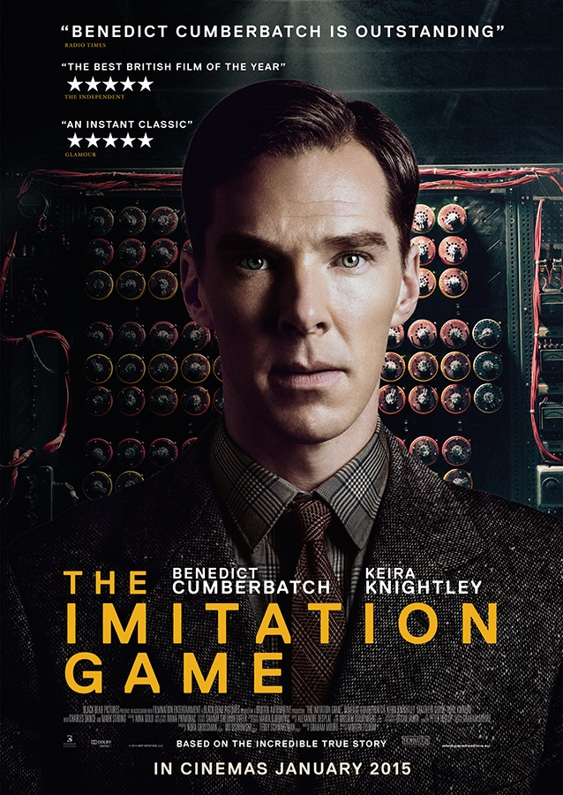
Alan Turing
British mathematician known for:
Turing Machines (1936)
Breaking German Enigma (WWII)
Turing Test (1950)
?

Slide 5
“I propose to consider the question, 'Can machines think?' This should begin with definitions of the meaning of the terms 'machine 'and 'think'. … [But] Instead of attempting such a definition I shall replace the question by another... The new form of the problem can be described in terms of a game which we call the 'imitation game'.“
-Alan Turing, “Computing Machinery and Intelligence”, 1950

Slide 6
The Imitation Game
Male
(Pretends to be female)
Interrogator
Female

Slide 7
The ‘Turing Test’
Machine
(Pretends to be human)
Interrogator
Human

Slide 8
“I believe that in about fifty years’ time it will
be possible to programme computers, with a
storage capacity of about 10⁹, to make them play
the imitation game so well that an average
interrogator will not have more than 70 per cent
chance of making the right identification after
5 minutes of questioning”
-Alan Turing (1950)

Slide 9
So ….?
What is the point of Turing’s Imitation Game?
A definition of intelligence?
A test for intelligence?
An argument for machine intelligence?
Other?

Slide 10
Definition of Intelligence?
Seems like a strange way to *define* intelligence:
Is this what intelligence *is*?!
And didn’t Turing say that he thought it was pointless to try and define intelligence?
Maybe it is an *operational* definition of intelligence
It doesn’t define what intelligence is, but still provides us with an objective way to ‘measure’ or ‘gauge’ intelligence

Slide 11
An Operational Definition?
The second is the duration of 9,192,631,770 periods of the radiation corresponding to the transition between the two hyperfine levels of the ground state of the cesium 133 atom.

Slide 12
Non-human like forms of intelligence
Goes against F $↔$ I
But maybe we still have: F $→$I

Slide 13
Standard Interpretation of the Turing Test

Slide 14
‘Passing’ the Turing Test
If the interrogator cannot figure out who is the machine and who is the human, then the machine is said to ‘pass the Turing Test’.
If a machine passes the Turing Test, then we should consider it intelligent.

Slide 15
Argument for AI
Premise 1: Machines can pass the Turing Test
Premise 2: Anything that passes the Turing Test is intelligent
Conclusion: Machines can be intelligent

Slide 16
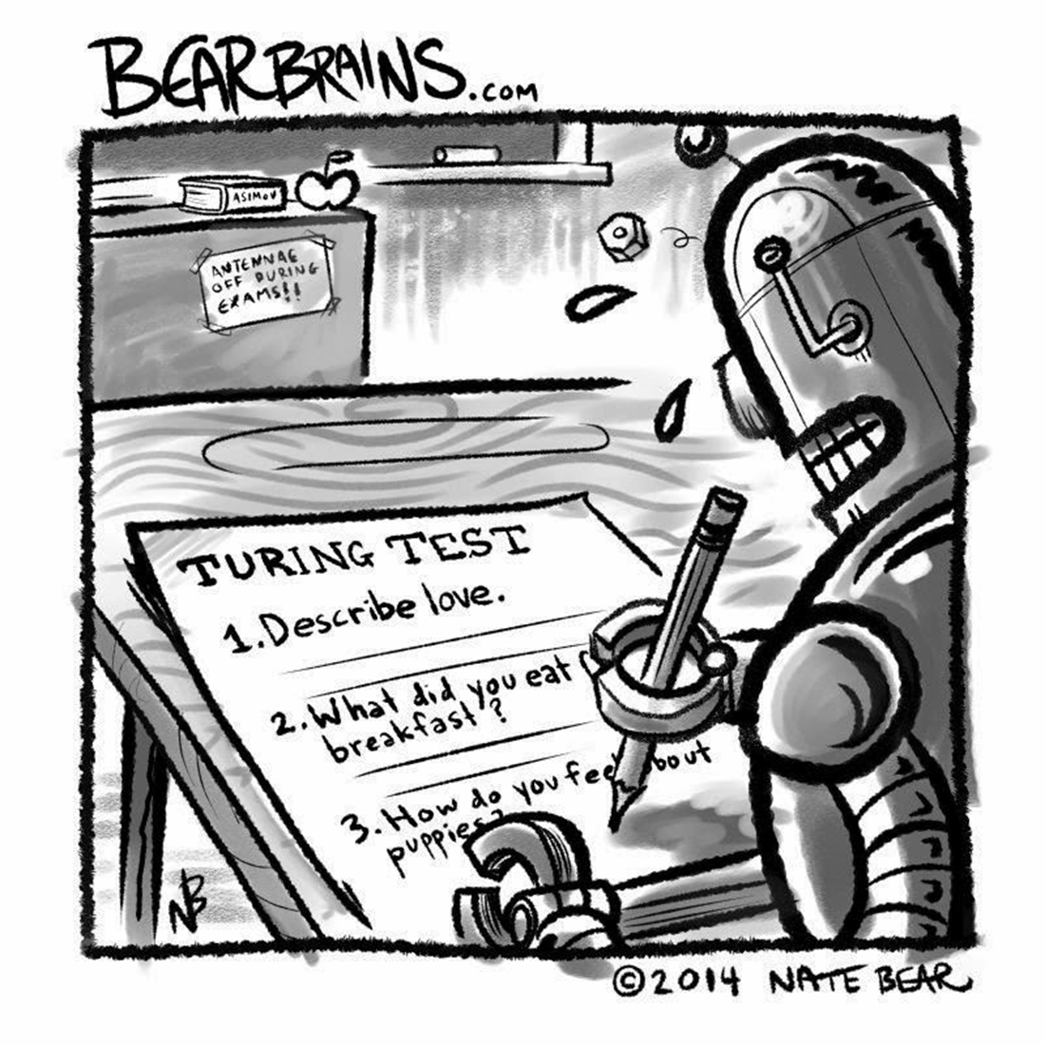
Can Machines pass the Turing Test?

Slide 17
Typical Objections
Machines can’t have emotions
They can’t make moral judgments
Machines can only do what they’re programmed to do:
They can’t learn
They can’t adapt
They can’t do anything creative

Slide 18
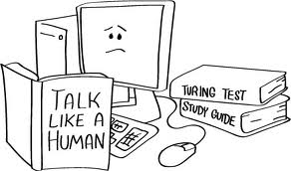
Is Anything that Passes the Turing Test Intelligent?

Slide 19
Typical Objections
Only tests for ‘verbal’ intelligence
What about other kinds of intelligence?
Test is sloppy
Who is interrogator? What is conversation about?
Test can be passed by simple tricks
Eliza

Slide 20
Loebner Competition
Annual competition held since 1990
$25,000 is offered for the first chatterbot that judges cannot distinguish from a real human … never been awarded yet

Slide 21
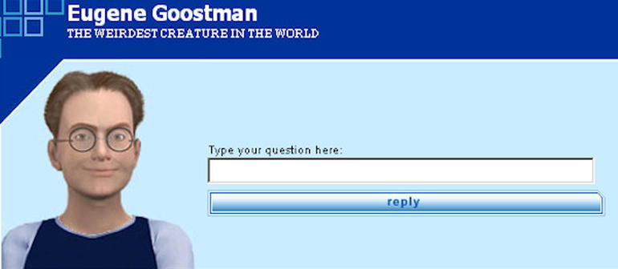
Eugene Goostman
In 2014, at a contest marking the 60th anniversary of Turing's death, 33% of the event's judges thought that the chatterbot Eugene Goostman was human; the event's organiser Kevin Warwick considered it to have passed Turing's test as a result.

Slide 22
The Turing ‘Test’ as Harmful!
In “Essentials of Artificial Intelligence”, Ginsberg defines AI as “the enterprise of constructing a physical symbol system that can reliably pass the Turing Test”
But trying to pass the test encourages building cheap tricks to convince the interrogator, which is exactly what we have seen with Eliza and other chatterbots
This kind of work has advanced the field of AI, and our understanding of intelligence and cognition … exactly zilch!

Slide 23
Grand Challenges
Maybe the Turing Test (and the Loebner competition) is a kind of Grand Challenge?
Landing people on moon
Chess (Deep Blue)
Urban Challenge (self-driving car)
Jeopardy (Watson)
But at this point in time, trying to create human-level intelligence in a computer is a Ridiculously-Grand Challenge

Slide 24
Non-Standard Interpretation of the Turing Test

Slide 25
‘Imitation Game’ vs ‘Turing Test’
But maybe Turing never intended to propose any kind of test for machine intelligence (let alone propose a definition, as some people say he did!).
In his original article Turing uses the word ‘pass’ or ‘passing’ 0 times, ‘test’ 4 times, and ‘game’ 37 times.

Slide 26
“But Intelligence Is More than Unimaginative Donkey-Work!”
In Turing’s time, the very idea of an intelligent machine was unthinkable to many people
Maybe Turing used the Imitation Game to counter these ‘kneejerk’ reactions, and force people to think with a more open mind about this issue

Slide 27
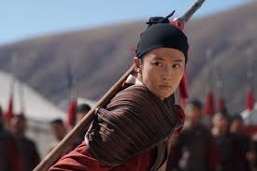
Mulan
The Imitation Game as a kind of parable to make the nay-sayers eat humble pie: Mulan!

Slide 28
Pluto, Flight, and Intelligence
We typically treat the question as to whether machines can think as a question about a matter of fact.
But maybe the question of machine intelligence is like these questions:
Is Pluto a planet?
Do airplanes fly?
These questions will not be answered by any amount of observations alone. Instead, we have to decide whether it makes sense to regard a machine as intelligent or not.

Slide 29
The original question, “Can machines think?”, I believe
to be too meaningless to deserve discussion. Nevertheless
I believe that at the end of the century the use of words and
general educated opinion will have altered so much that one
will be able to speak of machines thinking without expecting
to be contradicted.
-Alan Turing (1950)

