Slide 1
Some Comments on Free Will
Dr. John Milanese
RPI Fall 2020
1

Slide 2
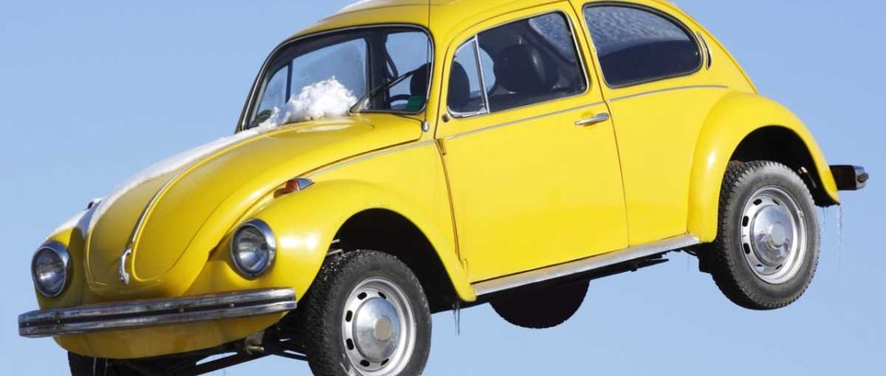
2

Slide 3
We were promised flying cars….
“We still don’t have them! When are we getting them?!”
“Well, we kinda do. Helicopters!”
I think free will is like this.
There’s a sense of free will that most people have in mind, and no, we don’t have that.
There another less obvious sense of free will, and we actually have that.
3

Slide 4
Is what your computer does “up to it”?
Does it have the freedom to have done otherwise?
What about a computer that instantiates AI?
Would an AI, for some action, be able to have done otherwise?
What about you?
Is machine-ness what matters? Or the kind of machine?
4

Slide 5
The plan for tonight
Considerations against free will
Considerations for it
Punchline: there is a tension between our common sense notion of free will (which we don't have) but this concept is unworkable, and a notion that is of more practical and theoretical importance (which we do have) and is workable.
5

Slide 6
Free will and responsibility
Free will is required for responsibility. You aren't really responsible for X if you could not possibly have chosen other than X.
Easy cases: We don't hold someone responsible for sneezing.
Or spilling a glass from reacting to a bee landing on them.
Harder cases: We don't hold someone responsible for thoughts and actions that we can see were caused by a brain tumor.
But tumors are just clear cases of neurologically explained actions...maybe all actions are like this and just aren't clear yet.
6

Slide 7
Quiz question 1
AGREE or DISAGREE. A conscious deliberate choice of yours is ultimately based in part on your desires. Your desires have neurophysiological states/events of your brain as their underpinnings. Those states of your brain are what they are in virtue of prior brain states and other inputs and influences. You could not, through conscious deliberate reflection, have chosen the entire prior cascading chain of neurolophysiological underlying states of your brain leading to your decision. So, you are not the conscious deliberate author of your choices, because your choices are a function of that which is outside of your conscious deliberate choice. So, your choices are not really examples of free will.
7

Slide 8
Quiz question 2
AGREE or DISAGREE. In a straightforward way, some actions and decisions are more “up to you” or “under your control,” than others. For example, you have only some control over what grade I will write on your paper, or how well you are able to navigate a car around a sharp turn in snowy weather. What you chose to do or not do matters, but only so much. On the other hand, you may have a greater degree of control over whether you will choose to drive the car in the snow at all. Or whether you get up and leave this lecture. What you do decisive. Because some actions and outcomes are more “up to you” it makes sense to think of these kinds of choices as more free for you to choose.
8

Slide 9
Common perspectives
If X was a free choice, you need to have been able to have done other than X.
If X was a free choice, your conscious intentions need to be why you did X.
9

Slide 10
Common arguments against free will
We are deterministic!
If we are deterministic, we aren't really in control.
If we are deterministic, our thoughts/efforts don't matter.
If we are deterministic, we are predictable, so not free.
There's no evidence of free will even in totally free choices.
10

Slide 11
Determinism and “free will”
Determinism (Def): given the state of the physical universe at a time t, all future facts of the physical universe after time t are necessitated (or given) by the prior facts and the laws of nature (future events are “set in stone” given prior events and laws).
We don't need this though... We can allow for plenty of quantum randomness. Our question: is the level of brains and human decision-making deterministic?
Alternatively: given the same set of neurological / sensory / informational inputs, would the mind produce the same output desires, hopes, fears and decisions?
11

Slide 12
Just check
Simple. Just give a person the same sensory / informational input over and over again multiple times, and see if they react the same every time.
12
12

Slide 13
Just check
Simple. Just give a person the same sensory / informational input over and over again multiple times, and see if they react the same every time.
“you can't step into the same river twice.” Attributed to Heraclitus
13
13

Slide 14
Run an experiment?
You could test this if we could just erase some person's memory.
14
14

Slide 15
15
15

Slide 16
Notice a natural experiment
You could test this if we could just erase some person's memory. (Ethics boards are such a drag...)
Luckily, nature sometimes sets an experiment up for you...
16
16

Slide 17
Global Transient Amnesia
Temporary loss of the ability to form new memories.
No clear understanding of the cause.
Still remember all the important stuff, but the very recent past is gone, and they can't remember what just happened 1 minute ago.
“Memory window” grows longer and longer.
Rare. Occurrence rate in the population of about 5 in 100,000.
YT Video: “It's Tuesday! (Global Transient Amnesia).
17

Slide 18
“Computationist Determinism”
Given a mind at a certain state, if you give it a set of inputs, the outputs are determined.
Give the mind the same set of inputs, same hospital room, etc. and see if the output changes. It's pretty consistent. “Creepy!......creepy!.....creepy!”
We are deterministic meat machines, we are like the GTA patient but with an open window rather than a loop.
18
18

Slide 19
DET → no control?
Is self-control ruled out by Det’ism? What does Det’ism imply about control?
19

Slide 20
DET → no control?
But the connection between determinism and control isn't clear. Don't assume DET → no control.
Even if X determines Y, that doesn’t show that...
(a) X controls Y, b/c I determine but don’t control dice
(b) Y isn’t self-controlling, b/c
Program the space probe, but self-controlling later. Another case of programming w/o control: “ Conway's LIFE”
And control doesn’t mean “can make it do anything”--piloting, driving are controlling w/o total control
Not clear that Det’ism rules out freedom by ruling out control...
20

Slide 21
DET → no mental causation?
“If Det'ism is true, my thoughts and efforts don't matter.”
All effort is absurd. Like “body english”
Does Det'ism rule out mental causation?
If Det'ism is true, then all events are fated. Fate and free will are incompatible.
21

Slide 22
DET → no mental causation?
“If Det'ism is true, my thoughts and efforts don't matter.”
Actually, if Det'ism is true, your (physical) thoughts and efforts are part of the deterministic causal story of why things happen. They do matter.
What about fate? That some events are fated to happen, and will happen no matter what.
22

Slide 23
Fatalism
23

Slide 24
DET'ism → no fate!
Actually, if Det'ism is true, everything happens only because of very specific reasons. Nothing ever happens “no matter what,” but rather because of prior states and the laws of nature.
Because according to DET'ism, if prior conditions were different, then some future event may be different.
24

Slide 25
Sam Harris' thought experiment
Think of a city, any city.
25

Slide 26
Harris continued...
Not free to choose those cities you don't know about.
Not free to choose that which did occur to you to choose.
You can't choose a city before you think of it, because then you'd have to think of it before you think of it.
Subjectively, some cities pop up into consciousness, for reasons you cannot inspect.
You choose one for reason unbeknownst to you.
Subjectively, it's like some other little person in your head chose it for you “behind a curtain.”
Your conscious intentions and deliberations are not why you do what you do.
26

Slide 27
Reasons for Incompatibilism
Subjectively: We are not the conscious author of the ultimate causes of why we choose what we do...
Objectively: if determinism is true, for any action we do, we could not have done otherwise
But is determinism what's critical?
27

Slide 28
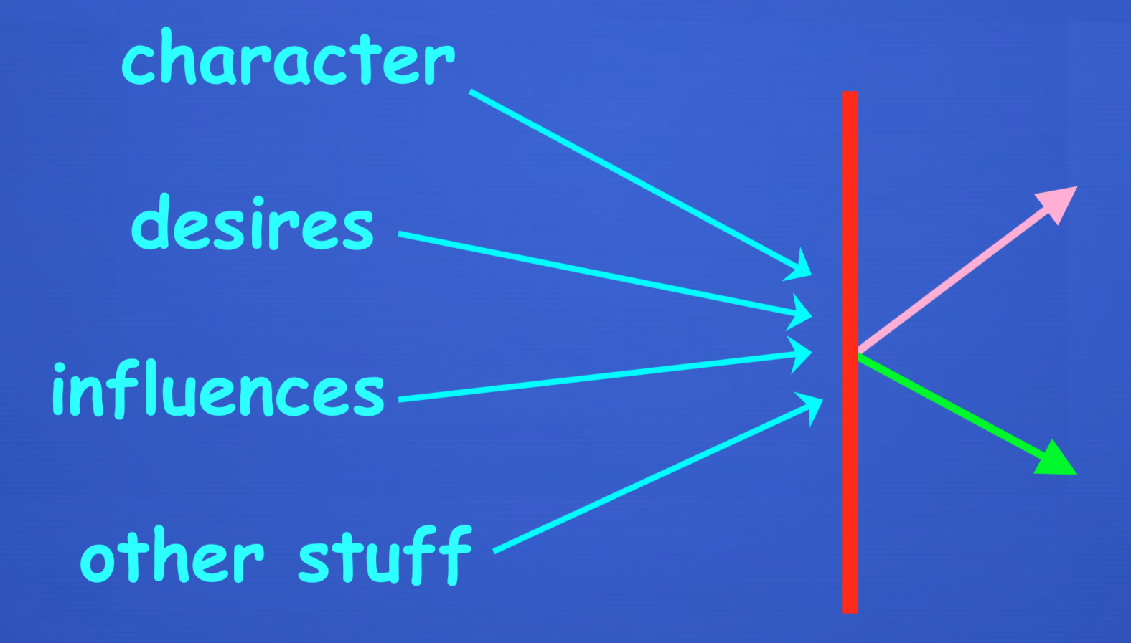
Is Determinism critical?
28

Slide 29
Random choice isn't free
Determinism may actually be requires for free choice.
Random choice isn't “up to me,” not a function of my desires.
29

Slide 30
Maybe Dualism will work
All this seems worrisome if I’m a machine of sorts. But what about dualism?
30

Slide 31
Dualism doesn’t help!
First-person subjective experience: But we still have the subjective problem: I still think and act for reasons unknown to me.
Third-person objective perspective: my dualistic soul-mind either works deterministic or not.
If deterministic, still have the ‘threat’ of determinism
If my soul thinks and chooses randomly, my thoughts and choices are less ‘up to me.’
31

Slide 32
32

Slide 33
The CHDO argument!
Whatever freedom is, I can only have it if for any free action “I could have done otherwise."
Possible problem for the compatibilist:
Freedom requires that ”I CHDO”
But Determinism seems to rule this out
So, the question: Is “CHDO” both
(a) required by freedom, and
(b) ruled out by Det’ism?
CHDO seems important for responsibility?
Idea: if for some action I could not have acted differently, I am (less) responsible for my action
33

Slide 34
Two senses
Two senses of “CHDO”: I CHDO...
1. Even if everything had been exactly the same
That is, I CHDO even w/exactly the same beliefs, desires, character, motivations, brain states, etc.
Det’ism clearly rules out #1
34

Slide 35
Second sense
2. If I'd wanted to (overall) That is, whether I do it or not is under my control
Seems like what we want for freedom – it’s mine, comes from my desires and deliberation.
But #2 is compatible with Det’ism – if it’s determined via my autonomous control, then I would have done otherwise if I’d (overall) wanted to.
So in the sense that “CHDO” is needed for freedom, it doesn’t seem to conflict w/Det’ism
35

Slide 36
“Compatibilism”
“Freedom is autonomy”
Autonomy vs heteronomy.
First-order desire versus second-order desire
deliberative self-control w/2nd-order desires playing a critical role
Idea: Actions caused that way bring responsibility
When 2nd-order desires are in control of 1st-order, our intuitions about responsibility are strongest
Limited agency w/less 2nd-order control -- e.g., kids
36

Slide 37
CHDO and responsibility
Couldn’t have done otherwise doesn’t rule out responsibility
It matters why you couldn’t have done otherwise
If it’s because of your character, you’re still responsible
Example: Mother Teresa can’t ignore the starving child, even if on some particular day she’d rather; and that’s praiseworthy
37

Slide 38
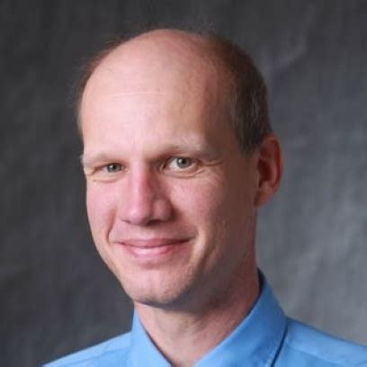
Bram plants a chip
38

Slide 39
One last CHDO point
Freedom doesn't require that you could have done otherwise, to somehow transcend the physical world but rather....
...it requires that your desires cause your actions in the right kind of way.
39

