Slide 1
Welcome to
the Wumpus World
Instructor:
Bram Van Heuveln
Wumpus World Generator:
Mark,Song,Alayn,Jessica,Samantha, Ian
Wumpus World Simulator:
Mitesh, Mindy, Xinyan, Qiao, Emma, Kevin

Slide 2
Installation Instructions
Before running the code, make sure you have installed:
Python: https://www.python.org/downloads/
Tkinter: https://tkdocs.com/tutorial/install.html
(may already be installed as part of Python)
Pygame: https://www.pygame.org/wiki/GettingStarted
cmd prompt (windows): py -m pip install -U pygame --user
Win32ui: https://pypi.org/project/pywin32/
cmd prompt (windows): pip install pywin32
Python and tkinter should be installed if taking CS1 Mac/Windows/Linux will have different installation instructions for each step

Slide 3
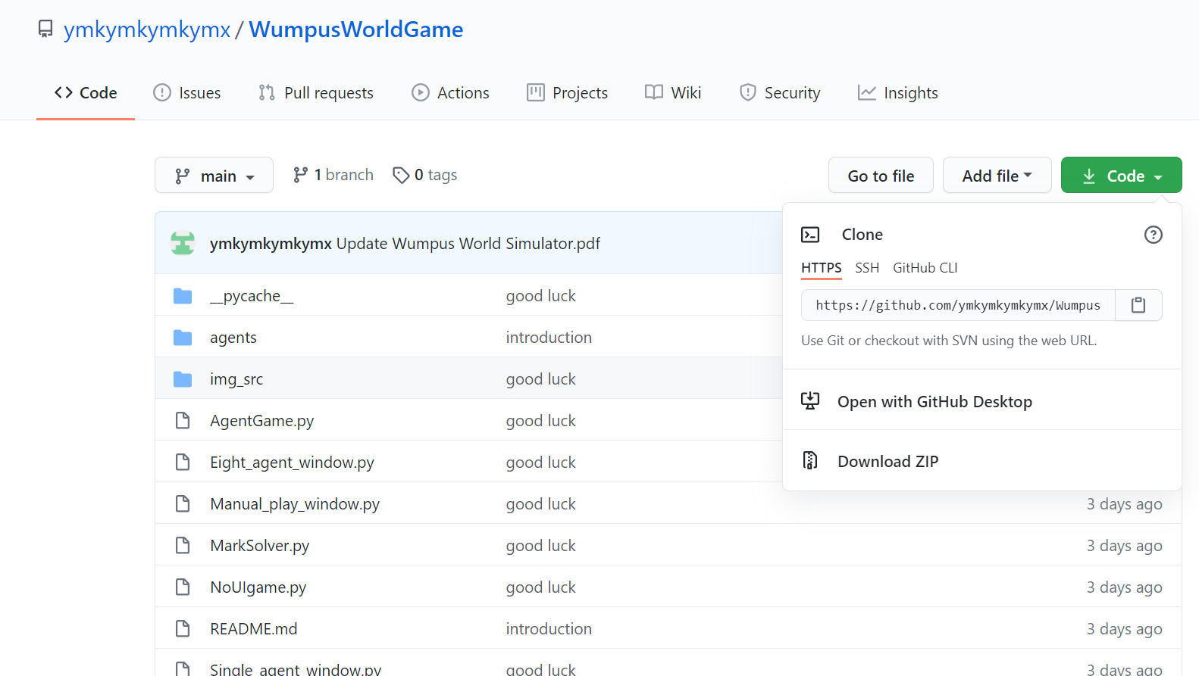
Download and Run Wumpus World
Link: https://github.com/ymkymkymkymx/WumpusWorldGame
Option 1: Download ZIP file directly from the GitHub browser and move it into your working directory
Option 2: Open command prompt cd to directory you want to work in git clone https://github.com/ymkymkymkymx/WumpusWorldGame
To run program, change to the WumpusWorld directory and run gui3.py in the command prompt: cd WumpusWorldGame python gui3.py

Slide 4
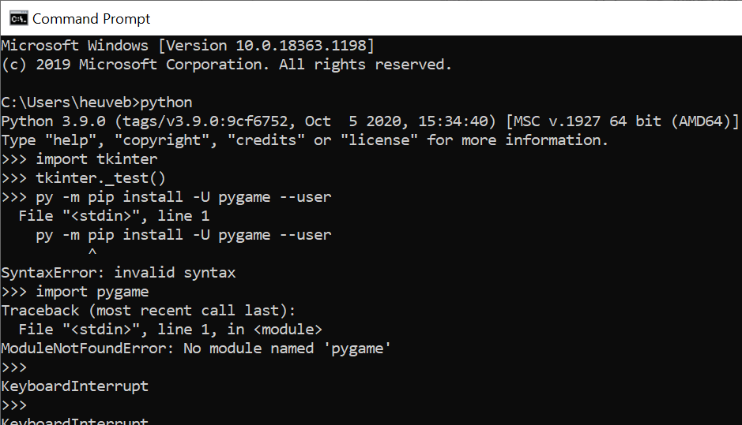

Slide 5
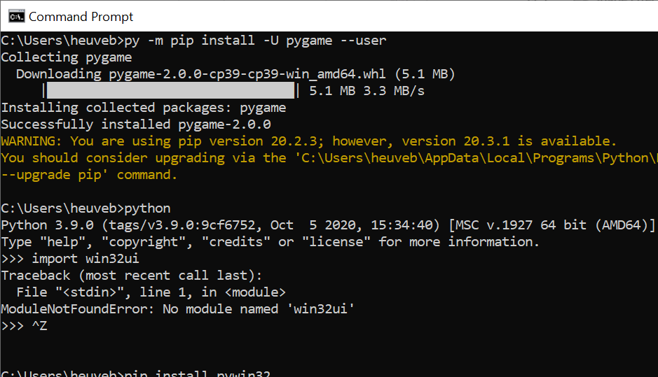

Slide 6
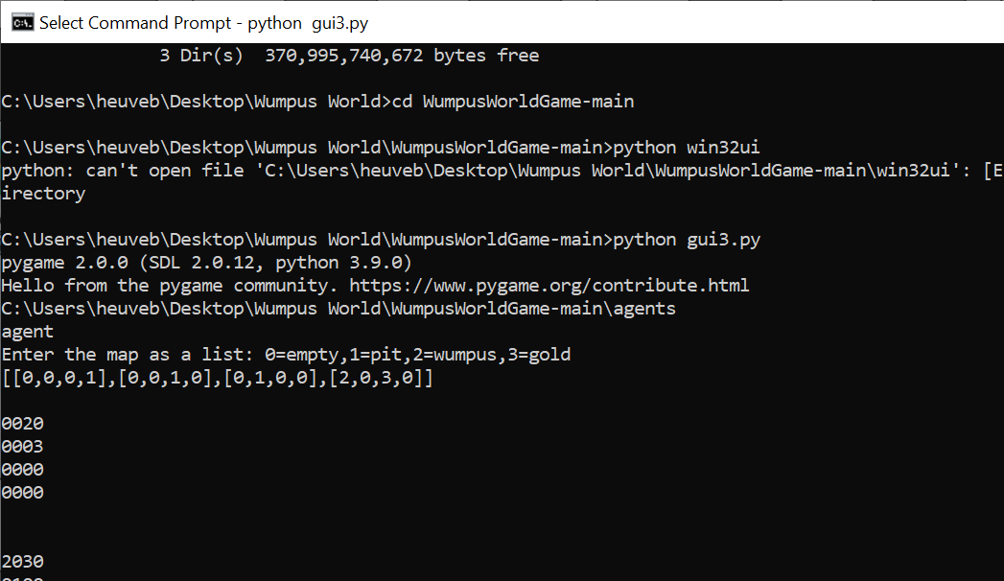

Slide 7
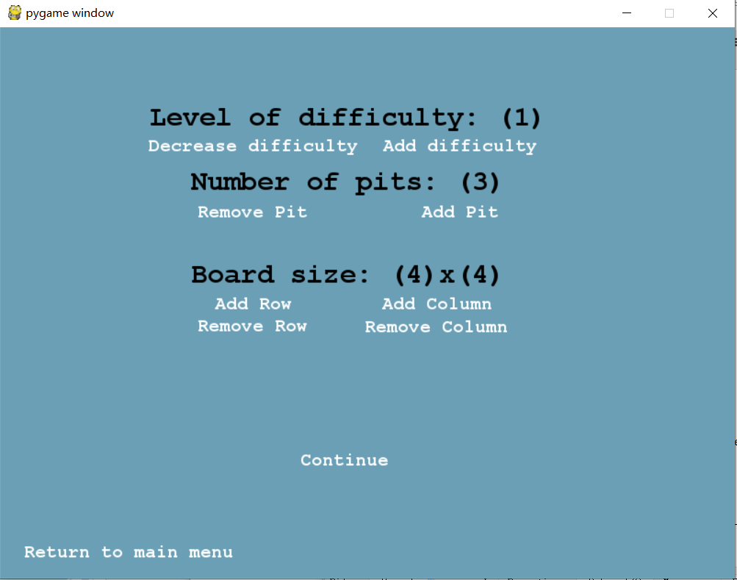
Intro to the UI windows
Open the gui3.py and enter the game you will see this page.
On this page you can set the level of difficulty and the Map information for manual game and single agent game.
There are four levels of difficulty. 0 and 1 are the levels that you don’t need to shoot the wumpus;
2 and 3 are the levels that you have to shoot the wumpus.
There are some combination of level and pits that cannot generate a map and cause the program to crash, just try more reasonable combinations when it happens.

Slide 8
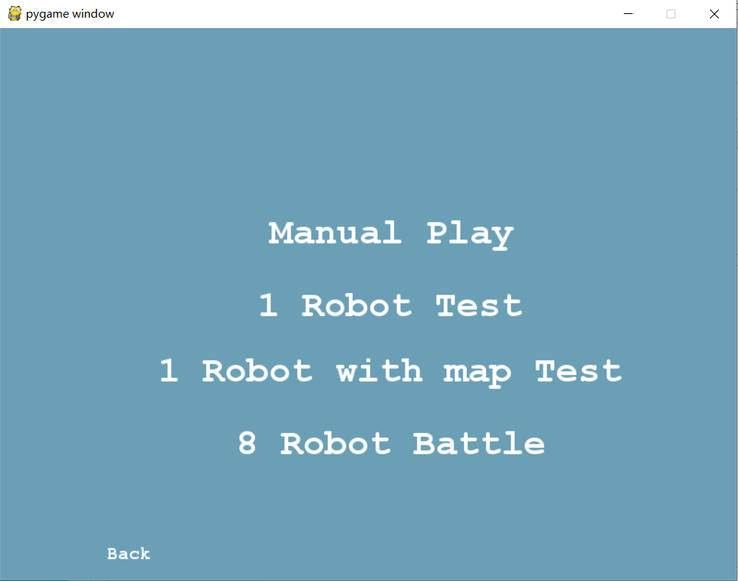
Intro to the UI windows
There are four modes to choose.
The Manual Play will start a game that you can play manually.
The 1 robot test will pop a window and ask you to choose your agent file and then let you play.
The 1 robot with map test will also ask you to enter a map in the command line.

Slide 9
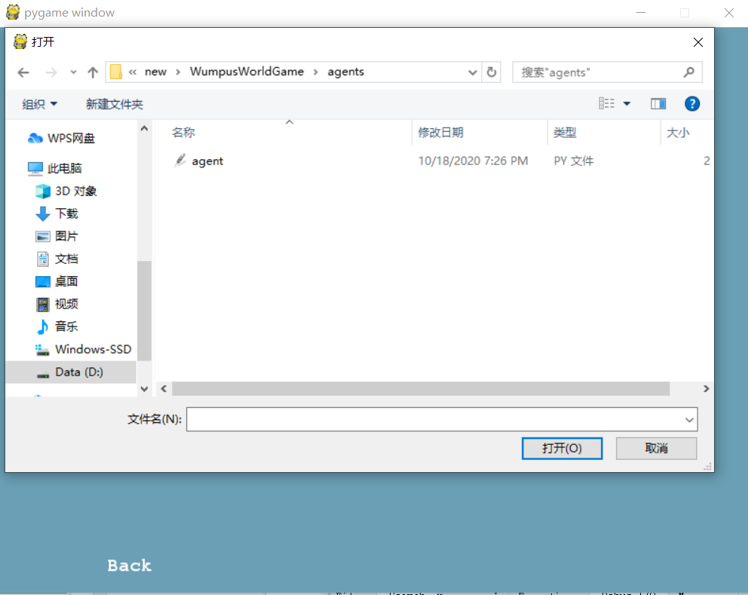
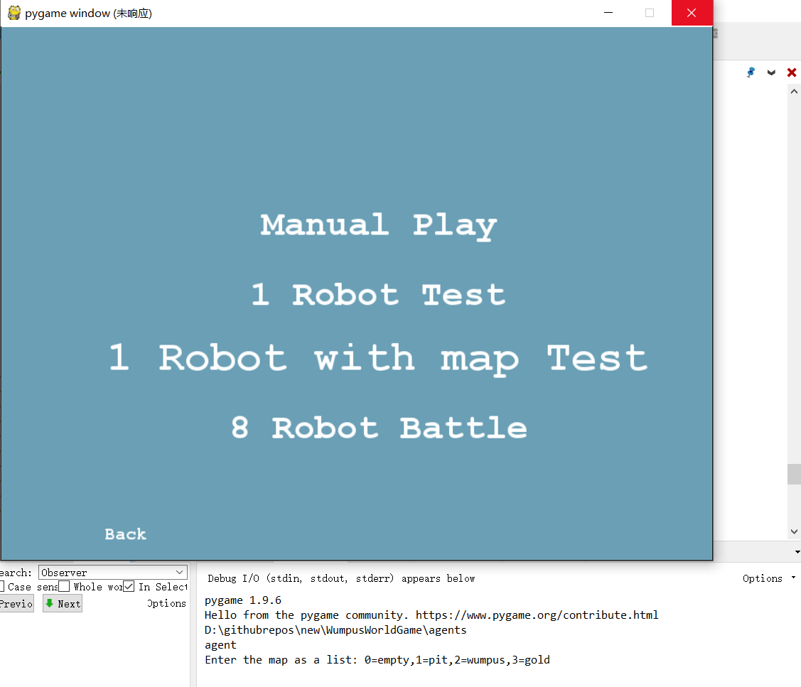
Intro to the UI windows
As you can see on the second picture, it ask you for a map.

Slide 10
Intro to the UI windows
Enter a map like this will let you start the game.
The robot will start at (0,0) of the map. Below is the representation rule of the map:

Slide 11
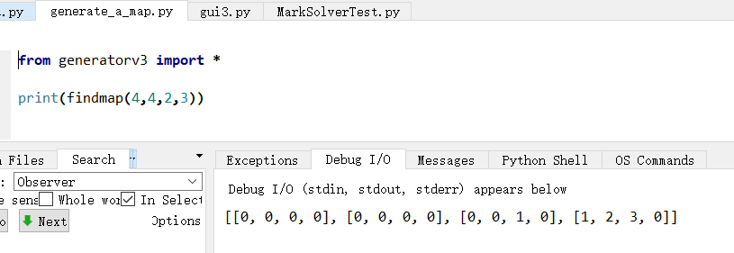
Intro to the UI windows
You can run generate_a_map.py to generate a random map.
The findmap function’s input is:
findmap(sizex,sizey,pits,difficulty)
Some maps that I used to test my robot:
[[0,0,0,0],[0,0,0,0],[0,0,0,3],[0,0,0,0]]
[[0,0,2,0],[0,0,0,3],[1,0,0,0],[0,0,0,0]]
[[0,0,0,1],[0,0,2,3],[1,1,0,0],[0,0,0,0]]
[[0,0,0,1],[0,0,1,0],[0,1,0,0],[2,0,3,0]]

Slide 12
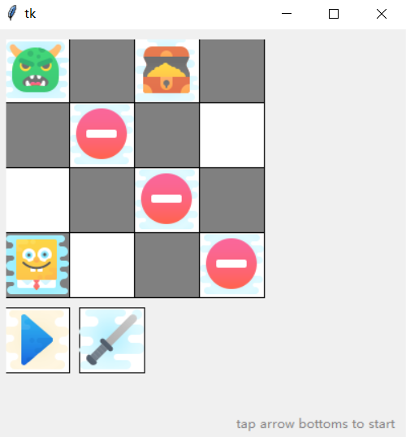
Intro to the UI windows
After entering the map, this window will pop up.
The blue button will let the robot automatically step through the whole game.
The sword button will let the robot make 1 step.

Slide 13
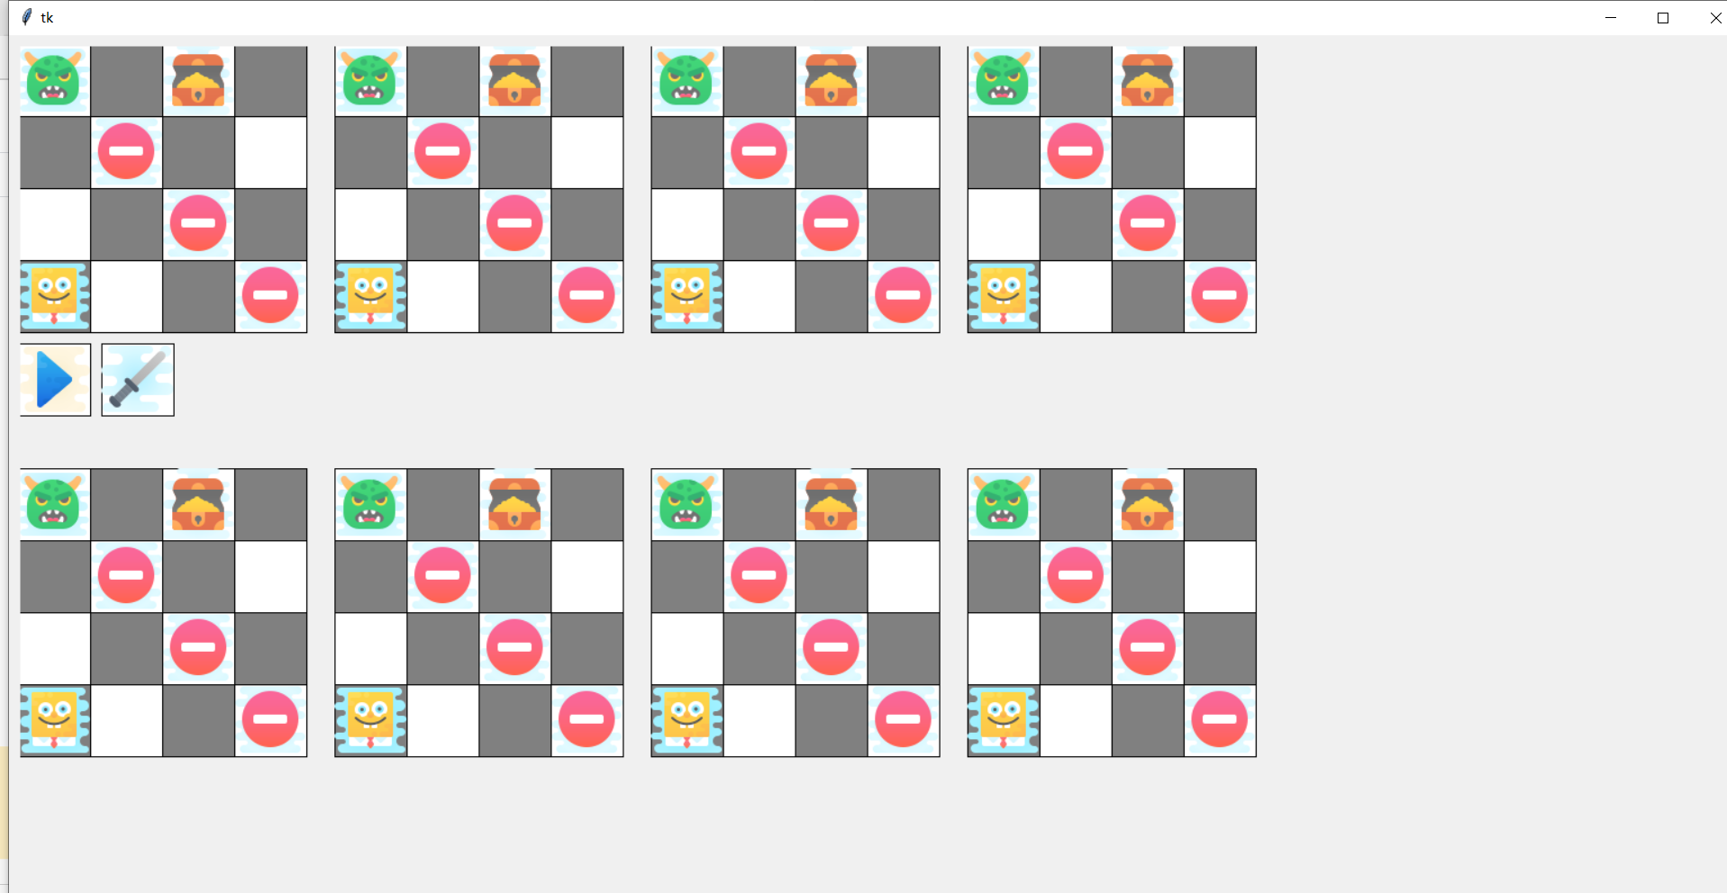
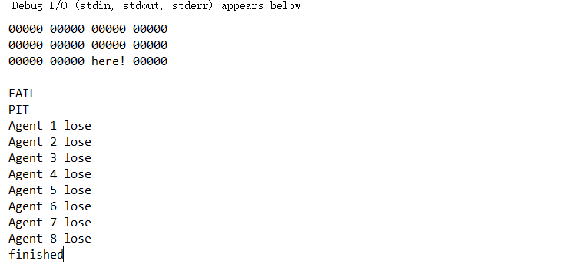
Intro to the UI windows
The 8 robot will ask you to choose 8 robots 1 by 1. Then it will ask you to enter a map on the command prompt. And then you will have 8 robots on screen like this:
After the game it will print out the result in the command line like below.
You can enter anything and the game will restart on the same map.

Slide 14
If you cannot use the gui3.py:
limitedUI.py is based on tkinter only.
NoUIgame.py is a text based game.
These two are different versions of 1 robot with map test.
They assume you will put your agent.py under agents folder.
Enter the agent file name without the .py when it asks you for agent.
Enter the map like before as it asks you for the map.

Slide 15
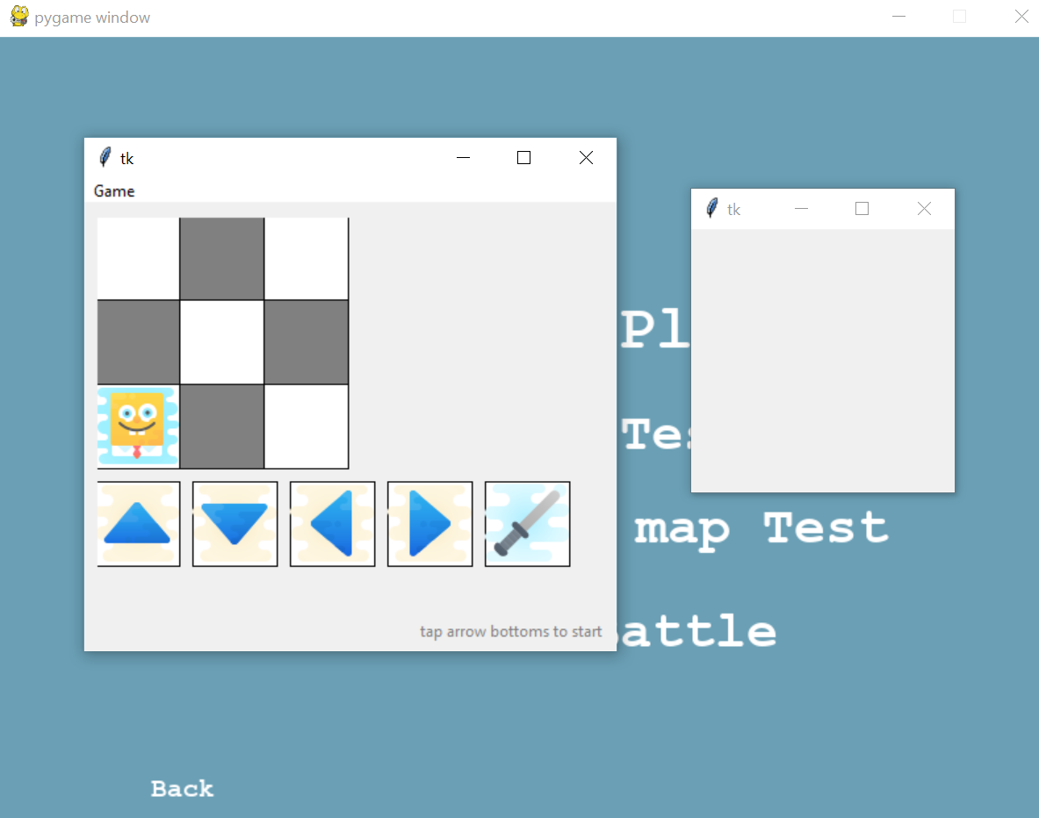
Important UI Information
In gui3.py, two tkinter windows will pop up. Move the blank and smaller window out of the way to focus on the map. Once finished with the main tkinter window, exit out of both tkinter windows. The main pygame window will not continue the program until the smaller tkinter window is closed.

Slide 16
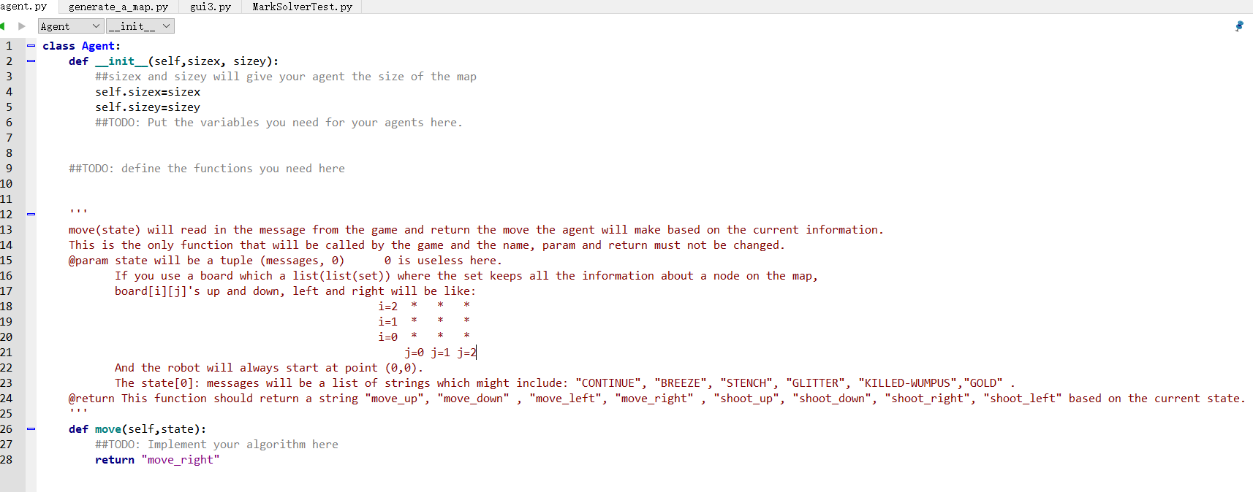
How to write a basic robot
The agent.py shows you the structure of a robot that will always move right.

Slide 17
How to write a basic robot
In the game, only the move() function will be called by the game environment and it should return a string like: "move_up", "move_down" , "move_left", "move_right" , "shoot_up", "shoot_down", "shoot_right", "shoot_left".
You can write your functions to choose from the strings above to return and the robot will move accordingly.

Slide 18
Thank you
Instructor:
Bram Van Heuveln
Wumpus World Generator:
Mark,Song,Alayn,Jessica,Samantha, Ian
Wumpus World Simulator:
Mitesh, Mindy, Xinyan, Qiao, Emma, Kevin

